Slide 1
Discriminant Analysis

Slide 2
Today . . .
  Another example
  Classification details
  Alternatives when assumptions fail

Slide 3
In this hypothetical example, data from 500 graduate students seeking jobs were examined. Available for each student were three predictors: GRE(V+Q), Years to Finish the Degree, and Number of Publications. The outcome measure was categorical: “Got a job” versus “Did not get a job.”

Slide 4
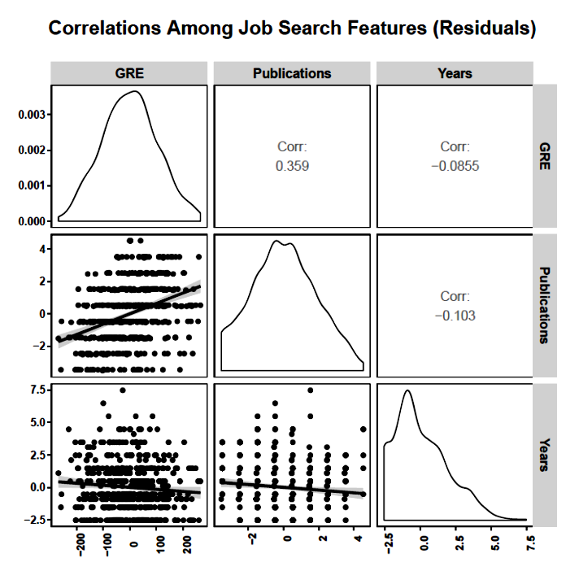
The data are not as clean as the iris data. The measures are less continuous and years has a lower bound (4 years) that creates a skewed and truncated distribution.

Slide 5
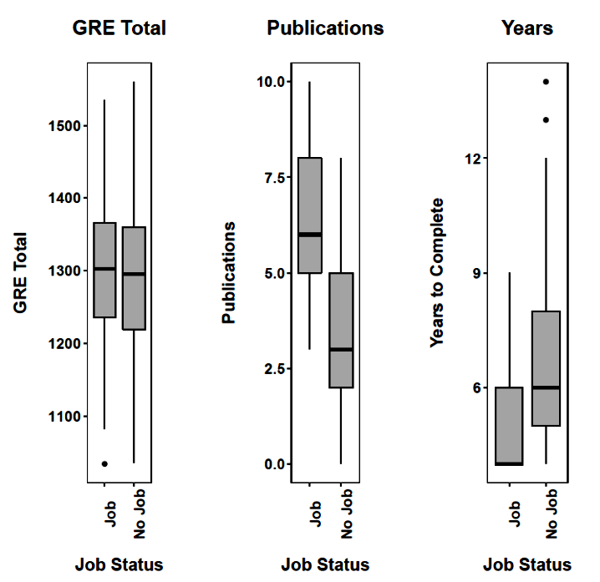
Years and publications individually separate the groups. GRE appears to make no difference.

Slide 6
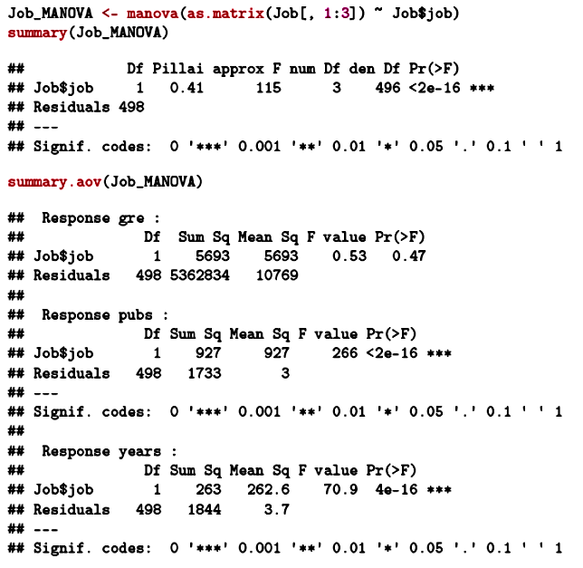
ANOVA confirms that years to finish and publications individually separate the groups.

Slide 7
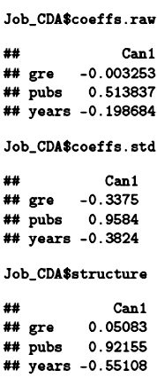
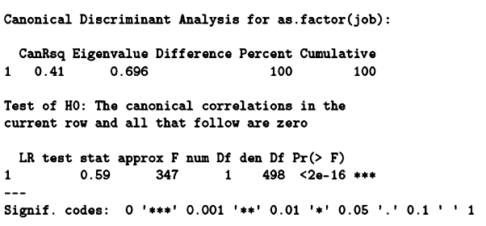
The lone possible discriminant function provides significant discrimination. Years and publications are unique contributors.
The number of publications is the most important variable. The message: publish often and finish quickly. Note the standardized coefficient for GRE.
Notes:
The partialled effect for GRE suggests a negative effect---perhaps an indication that those less gifted try harder.

Slide 8

One problem we confront in assessing these coefficients is that we have no information about their standard errors. Those are important if we want to make claims about coefficients being different from 0.
Later we will consider bootstrapping as a means to get that information.

Slide 9
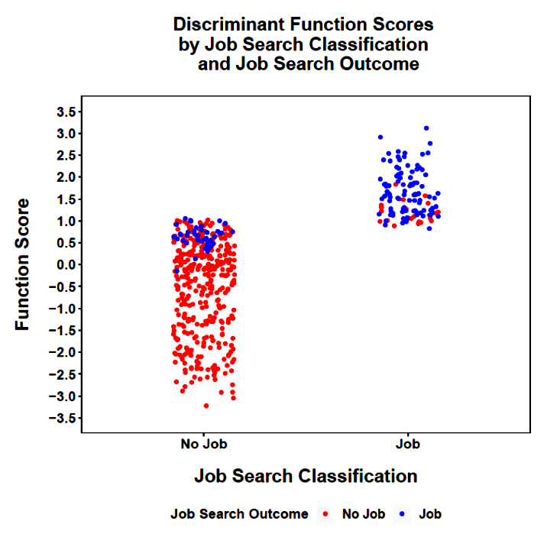
The separation of the groups on the discriminant function is clear.
Classification based on the discriminant analysis can be expected to be fairly accurate.

Slide 10
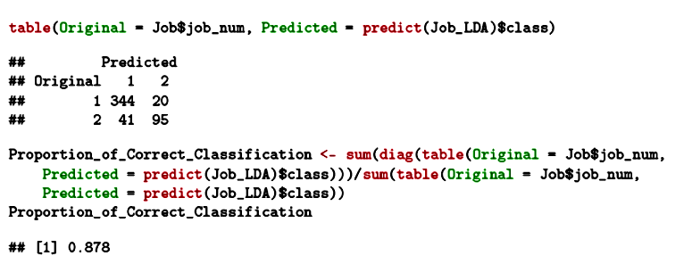
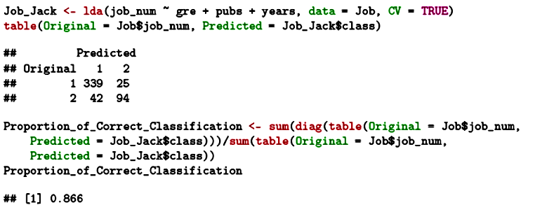
Simple classification of all cases.
Jackknife classification.

Slide 11
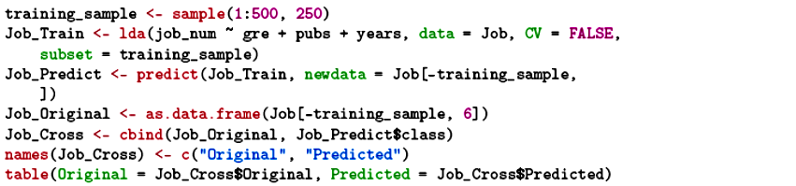
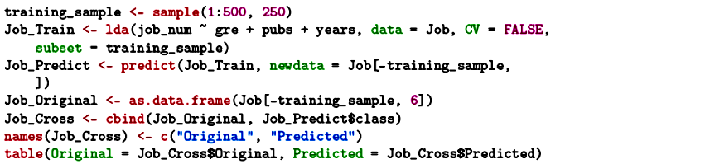
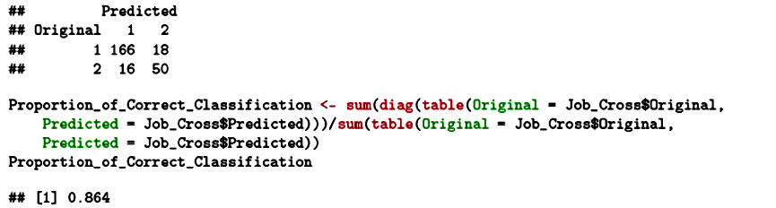
Split-sample classification.
Classification accuracy here will depend on the particular random split. Bootstrapping will help us see the variability of these estimates.
Notes:
A single cross-validation is open to variability, especially as the sample sizes decrease.
This variability can be made apparent with the bootstrapping procedure described later.
If sample sizes are very large, the entire sample can be split into multiple subsamples, called folds, and a K-fold cross-validation conducted.
This uses, in turn, one of the subsamples as the validation group with the remaining subsamples used as the training sample.
The mean classification can be taken across the multiple validations and variability can be directly estimated.

Slide 12
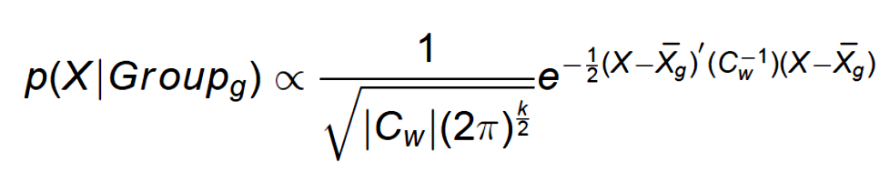
Under the assumption of multivariate normality, the probability of a particular profile of scores (X) given a particular group centroid and pooled covariance matrix can be estimated:
The pooled within-group covariance matrix is used if the homogeneity assumption holds.
Notes:
If the matrices are not homogeneous, then the quadratic form of discriminant analysis can be conducted. It uses separate covariance matrices. These are necessarily less stable and so the quadratic version will have lower power if used when the standard version is justified.

Slide 13
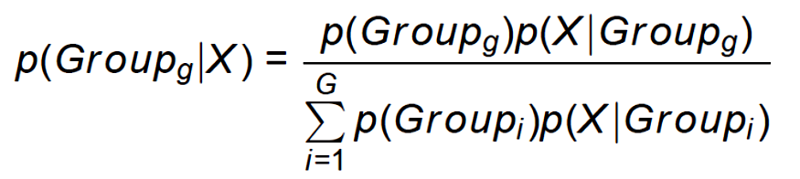
The posterior probabilities take prior probability of group membership into account:
In the iris data, the prior probabilities were equal (.33) but for the current data, the prior probability of getting a job is smaller (.272 ) than the prior probability of not getting a job (.728; from the sample proportions). We assume the sample is representative.

Slide 14
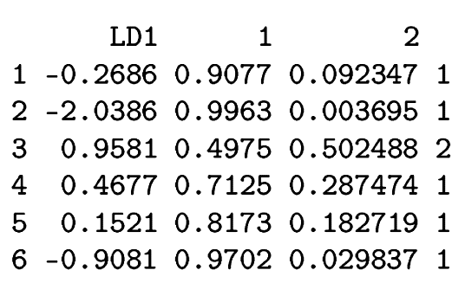
The case is assigned to the group with the highest posterior probability. The posterior probabilities are particularly useful because they indicate our confidence in classification.

Slide 15
Is the classification better than would be expected by chance? We first need to know the correct classification that would occur by chance:
Expected
No Job
Job
All
Actual
No Job
(q₁N)²
N
q₁N
Job
(q₂N)²
N
q₂N
All
q₁N
q₂N
N
Note that we assume the expected marginals to be the same as the actual marginals.

Slide 16
Is the classification better than would be expected by chance? We first need to know the correct classification that would occur by chance:
Expected
No Job
Job
All
Actual
No Job
(q₁N)²
N
364
Job
(q₂N)²
N
136
All
364
136
500
Note that we assume the expected marginals to be the same as the actual marginals.

Slide 17
Is the classification better than would be expected by chance? We first need to know the correct classification that would occur by chance:
Expected
No Job
Job
All
Actual
No Job
264.99
99.01
364
Job
99.01
36.99
136
All
364
136
500
(364 x 364)/500

Slide 18
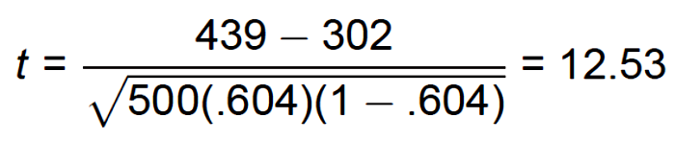
The total number of correct classifications that would occur by chance (302, 60.4%) can be tested against the actual number of correct classifications given the discriminant analysis model (439, 87.8%, for the simple prediction of all cases).
A t-test can be calculated:
where the denominator is the standard error of the number of correct classifications by chance (the null hypothesis).

Slide 19
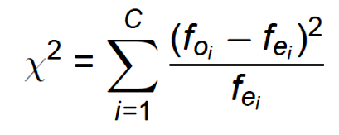
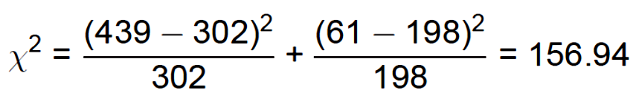
The difference between chance expected and actual classification can be tested with a chi-square as well.
Because this is a single degree of freedom test, t² = χ².

Slide 20
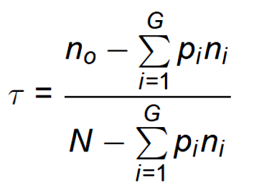
Klecka’s tau(τ) is sometimes calculated for classification results:
n_{o} is the number of correct classifications, n_{i} is the number of cases in group i, p_{i} is the proportion of the total sample expected to be in group i, G is the number of groups, and N is the total sample size.

Slide 21
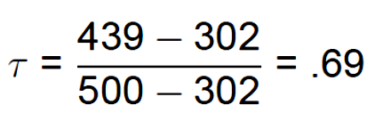
This is interpreted as the proportional improvement in classification over random assignment to groups. Values can range from 0 to 1. This is very similar to Cohen’s kappa.
Is an obtained τ value different from 0? The sampling distribution of τ is unknown and so a convenient formula for the standard error is not available. The bootstrap procedure will help here as well.

Slide 22
Several additional classification indices can be useful. In the following, an “event” is “getting a job”:
Precision: "What percentage of predicted events
are correct?"
Recall: "What percentage of events were
correctly predicted?"
F1: Harmonic mean of precision and recall.
Prevalence: "What is the proportion of actual
events in the sample?"
Detection Rate: "What proportion of the entire
sample are correctly predicted events?"
Notes:
The harmonic mean is the reciprocal of the arithmetic mean of the reciprocals.

Slide 23
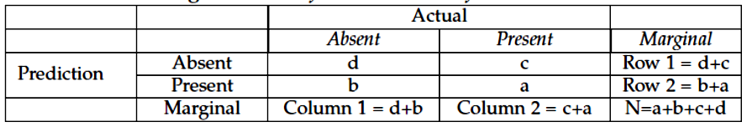






Slide 24
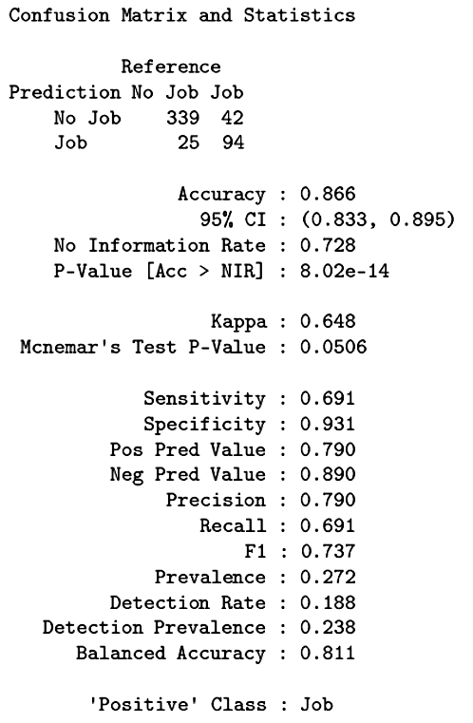
The discriminant analysis produced predictions that were correct quite often (.79) and in particular correctly identified getting a job fairly well (.69), despite getting a job being a relatively rare event (.27).

Slide 25
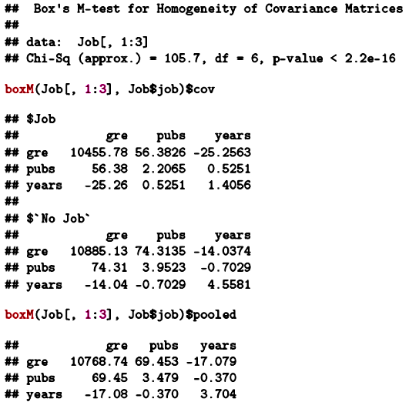
If the assumptions fail seriously then classification and inferences can be affected.
The covariance matrices are not homogeneous.

Slide 26
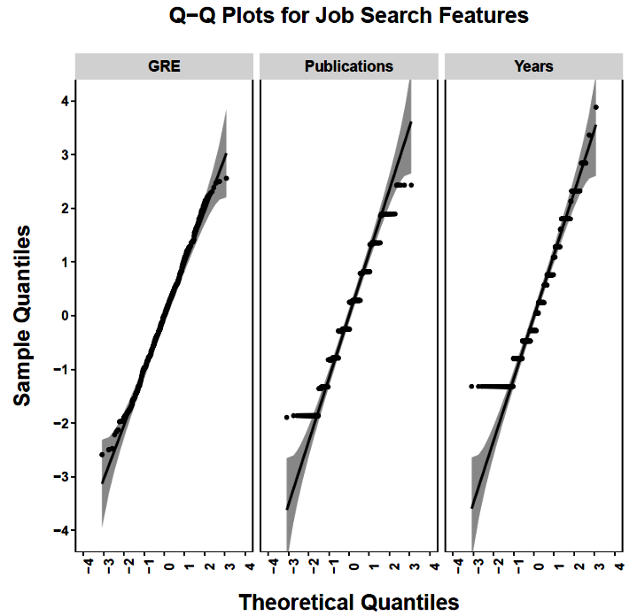
GRE appears to be normally distributed. Publications and years, however, look a little flaky (technical statistical term).

Slide 27
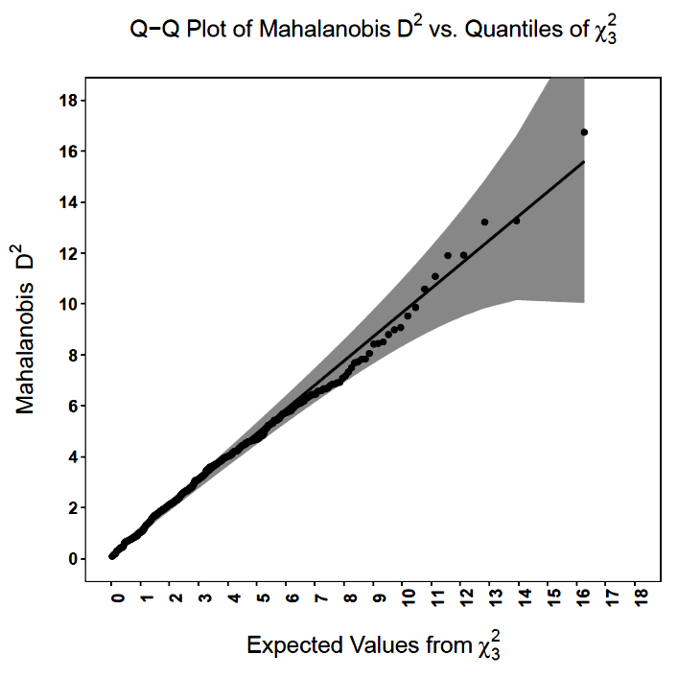
Collectively there are no outliers.

Slide 28
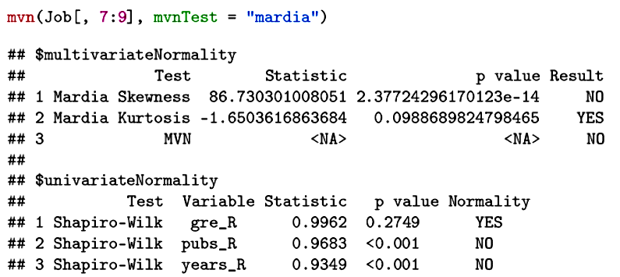
The significance tests for normality are surely being influenced by the very large sample size.
If we have doubts about the legitimacy of significance tests or classification based on normality, we can use methods that don’t rely on that assumption.

Slide 29
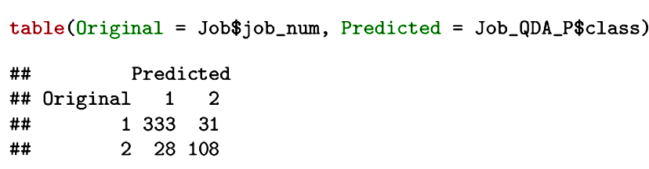
When the homogeneity of covariance matrices assumption fails, a pooled within-groups covariance matrix is not appropriate. An alternative form of analysis known as quadratic discriminant analysis can be used. This uses the separate group variance- covariance matrices in the classification process.
The jackknife classification is nearly identical to the original analysis.

Slide 30
If the assumptions underlying the discriminant analysis (homogeneous covariance matrices, multivariate normality) are not viable, the bootstrapping approach can be taken.
In bootstrapping, we assume that whatever population the sample came from, the sample is representative of that population. Therefore we can sample randomly from the sample, with replacement, to get multiple samples of the same size on which we can repeat the analyses.
The resulting empirical sampling distributions can be examined to assist inferences.

Slide 31
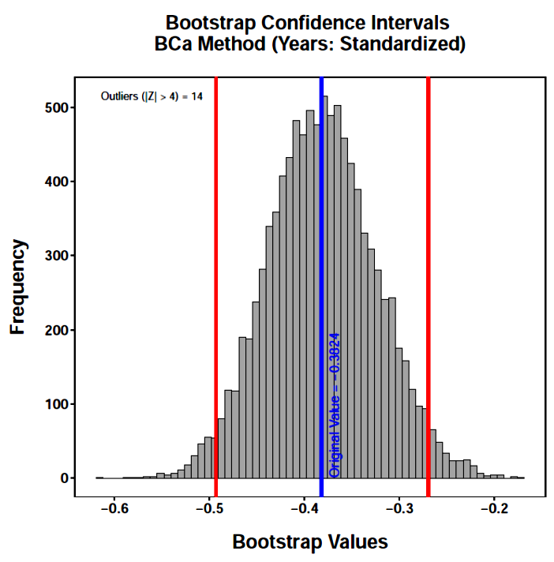
The 95% confidence intervals for the standardized discriminant coefficient for years excludes 0.

Slide 32
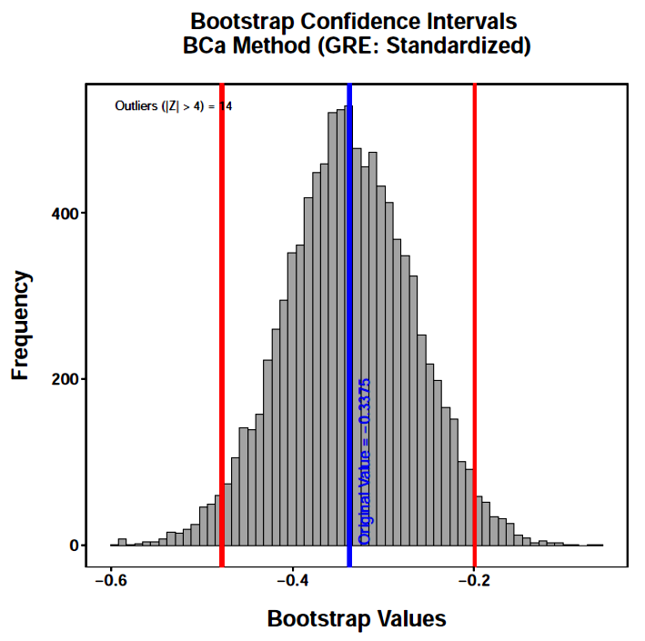
Similarly, the bootstrap estimates for the standardized discriminant coefficient for GRE are less than 0.

Slide 33
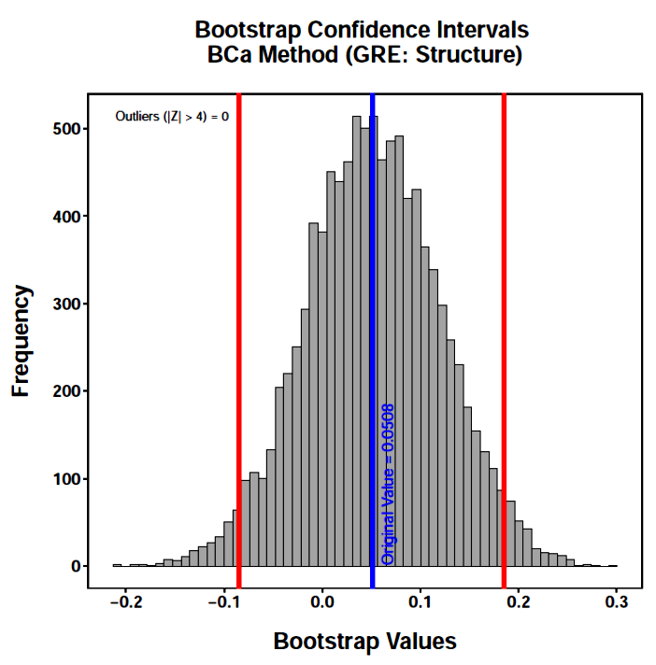
But, the 95% confidence interval for the GRE structure coefficient includes 0.

Slide 34
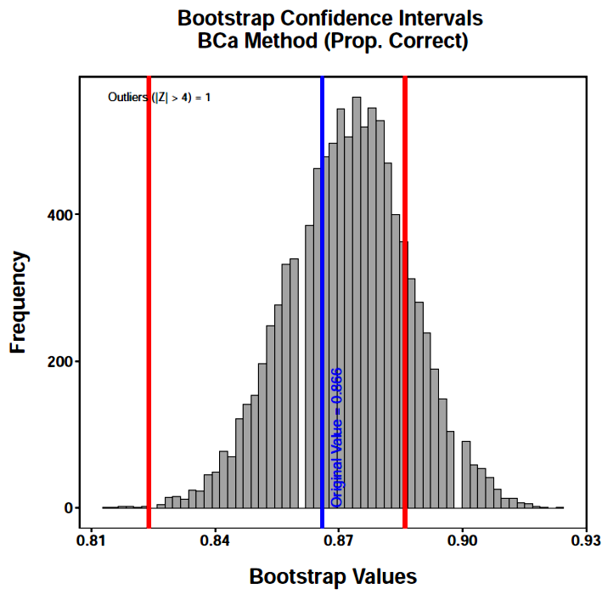
Classification is accurate and between about 82% and 88% with 95% confidence.
Note the shift in the confidence interval relative to the distribution.

Slide 35
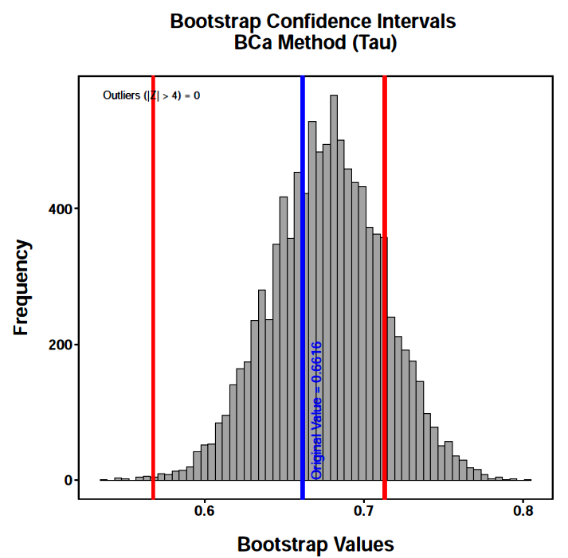
The proportional gain in classification over chance (τ) is moderate. Bootstrapping is particularly useful here because the sampling distribution of τ is unknown.

Slide 36
Bootstrapping is helpful if multivariate normality is out of the question, homogeneity of covariance matrices is not tenable, or sampling distributions are unknown.
But, other “problems” require a different approach. What if the groups are ordered in some way that we would like to incorporate into the statistical model? What if we have particular interest in comparisons among some of the groups? What if we would like to include interactions or polynomial terms with the predictors?

Slide 37
Next time . . .
Logistic regression

